Slide 1
The 3 R’s for the Earth Day
What can we do to save our earth?
(為了地球，我們可以做些什麼?)

Slide 2
What can you do with this?

Slide 3
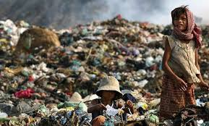
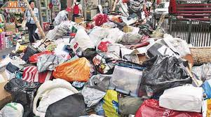
If we keep producing trash…..
Can you imagine living in a world with trash, trash, everywhere?

Slide 5
The 3 R’s
減 量
再利用
回 收

Slide 6
Reduce
Turn off the lights when they are not in use.
(隨手關燈)

Slide 7
Reuse
Plant in a used light bulb.
(利用廢棄的燈泡美化環境)

Slide 8
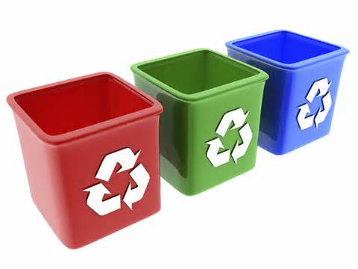
Recycle
Put the used light bulb in the recycle bin.
(回收廢棄燈泡)

Slide 9
Let’s Sing !
Use only necessary energy (只使用足夠的能源)
Take quick drinks (快速喝水)
Pull out plugs (拔插頭)
Throw away litter/pick up trash (丟垃圾)
Reuse stuff (東西): bottles/bags/
containers /rags (毯子)
Donate (捐贈) toys/clothes
Recycle cardboard (紙箱) /cartridges (充電器)/
batteries (電池) /laptops (筆記型電腦)/
cellphones/metals (鐵)

Slide 10
Let’s Sing !

Slide 11
How can we…?

Slide 12
It’s FUN time
Line up in front of the desk, and take turns to answer the questions.
Look at the pictures of each question.
Raise the card with either “reduce”, “reuse”, or “recycle” that responds to the actions taken in the pictures.
If you answer right, you’ll get a point for your group.

Slide 13
Donate old toys. (捐贈玩具)

Slide 14
Walk to school. (走路上學)

Slide 15
Bring a shopping bag. (攜帶購物袋)

Slide 16
Recycle dead batteries. (回收電池)

Slide 17
Wrap lunch box with old newspaper.
(用舊報紙包便當)

Slide 18
Bring your own chopsticks.
(攜帶環保筷)

Slide 19
Turn off the water when brushing teeth.
(刷牙時，關水龍頭)

Slide 20
Buy second-handed books.
(買二手書)

Slide 21
Recycle cans. (回收鐵鋁罐)

Slide 22
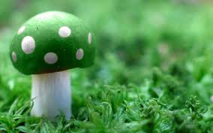
Good Job!

