Slide 1
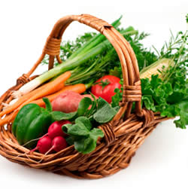
LOHAS
Eat organic food is a great start towards a healthier life.

Slide 2
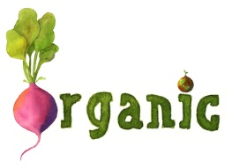
What is LOHAS?
Do you know what the meaning of LOHAS is? It is a new Lifestyles Of Health And Sustainability.
LOHAS consumers’ lifestyle and purchasing decisions are informed by their values regarding personal, family and community health, environmental sustainability and social justice.

Slide 3
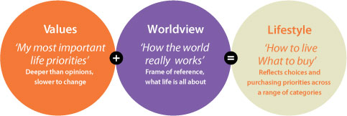
These values and attitudes are driving the markets for products as diverse as renewable energy, solar hot water, organic foods, recycled and sustainable homewares, domestic rainwater tanks, sustainable timbers, natural cleaning products, alternative medicine, yoga and eco-tourism.
Picture from: http://www.lohas.com/

Slide 4
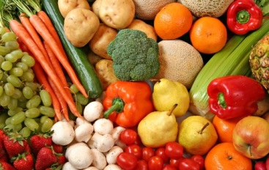
LOHAS includes many issues:
Organic and locally grown food
Hybrid and electric cars as well as city bicycles
Fair trade products
Green and sustainable building
Energy efficient electronics or appliances

Slide 5
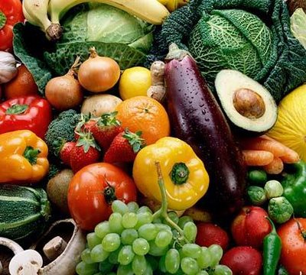
Let’s talk about organic food. Do you know what is organic food?

Slide 6
The word: organic
“Natural" does not equal “ organic ".
The term “organic” refers to the way agricultural products are grown and processed.
Specific requirements must be met and maintained in order for products to be labeled as "organic".
Grown in safe soil.
Have no modifications. (Genetically Modified Organisms )
Are not allowed to use chemicals or preservatives.

Slide 7
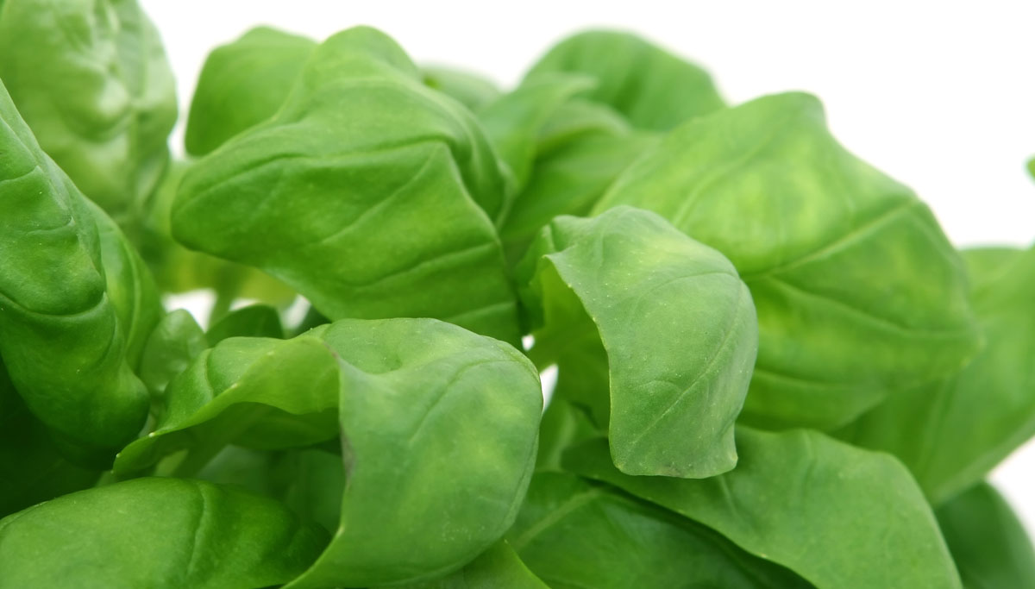
Organic vs. Non-organic food
Organic food
Grown with natural fertilizers.
The symptoms of disease lessen when they eat organic food
Non-organic food
Grown with synthetic or chemical fertilizers.
Cause "body burden" as it could lead to health diseases.
Reduces pollution and conserve resource.
Bad for the environment and kill creatures.

Slide 8
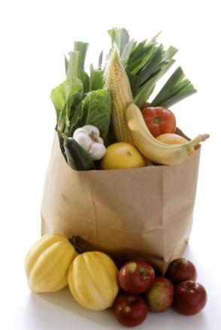
More benefits of organic food.
Fresh food:
Local food is the freshest food you can purchase. Fruits and vegetables are harvested when they are ripe and thus full of flavor.
Fruits and vegetables are also the cheapest when they are in season. You can also find out when produce is delivered to your market.

Slide 9
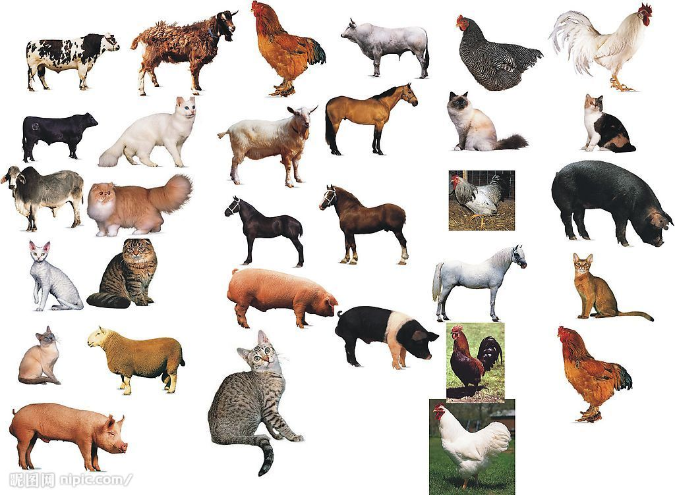
More benefits of organic food.
Organically raised animals:
Organic meat, dairy products, and eggs are produced from animals that are fed organic feed and allowed access to the outdoors.
Fed organic feed
Are fed solely on a diet of grass or hay, and not given antibiotics, growth hormones.
Access to the outdoors
Be kept in living conditions that accommodate the natural behavior of the animals.
Weren’t confined to a cage, so livestock will be more healthy.
Been shown to have more of the healthy omega-3 fatty acids.

Slide 10
More benefits of organic food.
More nutrients and less pesticides:
Organic foods have more beneficial nutrients, such as antioxidants. And contains fewer fungicides, herbicides, pesticides and insecticides.
They won’t have an accumulated build-up of pesticide exposure in our bodies due to numerous years of exposure.

Slide 11
Fruits and vegetables where the organic label matters the most.
Apples
Bell Peppers
Carrots
Celery
Cherries
Grapes
Kale
Lettuce
Peaches
Nectarines
Strawberries
Peaches
Let’s eat them NOW!!!

Slide 12
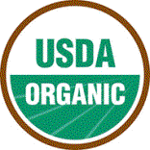
Organic food labels
1.USDA Certified Organic Food Labels
in the U.S.
100% Organic – Foods that are completely organic or made with 100% organic ingredients may display the USDA seal.
Organic – Foods that contain at least 95% organic ingredients may display the USDA seal.

Slide 13
Organic food labels
1.USDA Certified Organic Food Labels
in the U.S.
Made with organic ingredients – Foods that contain at least 70% organic ingredients will not display the USDA seal but may list specific organic ingredients on the front of the package.
Contains organic ingredients – Foods that contain less than 70% organic ingredients will not display the USDA seal but may list specific organic ingredients on the information panel of the package.

Slide 14
Organic food labels
2. European Union Certified Organic Food Labels
At least 95% of the product's ingredients of agricultural origin have been organically produced;
the product complies with the rules of the official inspection scheme.
The product has come directly from the producer or preparer in a sealed package.
The product bears the name of the producer, the preparer or vendor and the name or code of the inspection body.

Slide 15
Organic food labels
3. Australian Certified Organic Food Labels
Lower nitrate levels.
Higher vitamin C levels.
Higher levels of selenium.

Slide 16
Organic food labels
4. Canadian Certified Organic Food Labels
Only products with organic content that is greater than or equal to 95% may be labelled as: "Organic" or bear the organic logo.
Multi-ingredient products with 70-95% organic content may have the declaration: "contains x% organic ingredients." These products may not use the organic logo and/or the claim "Organic".
Multi-ingredient products with less than 70% organic content may only contain organic claims in the product's ingredient list. These products may not use the organic logo.

Slide 17
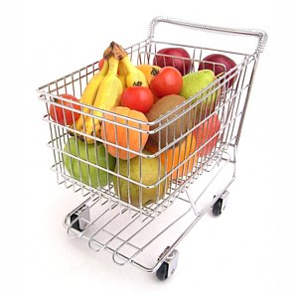
In the end
Do you remember all these information and important tips?
Let’s eat organic food with the first step of going LOHAS!!!

