Slide 1
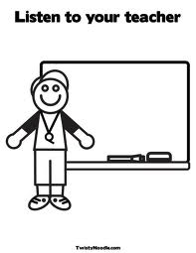
Expectations for you

Slide 2
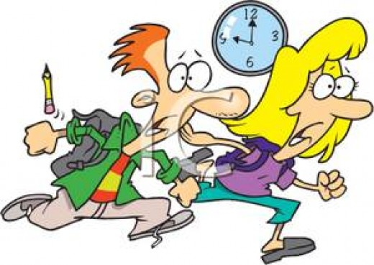
1. Be on time

Slide 3
2. Be prepared

Slide 4
Bring all your materials to class
every day

Slide 5
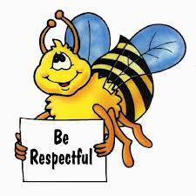
3. Be respectful

Slide 6
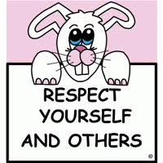

Slide 7
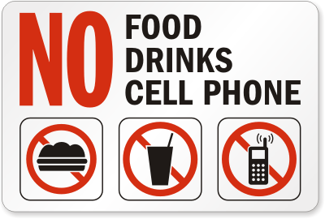
But you can bring water

Slide 8
When the bell rings…….
When you enter the classroom, turn off your cellphone , put it in your desk and then be in your seat.

Slide 9
No watching videos, taking pictures, videotaping,
messaging, chatting or playing games with your
cellphone.

Slide 10
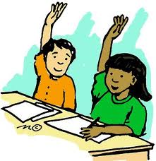
Always ask for permission first

Slide 11
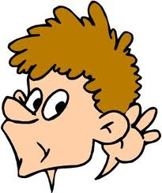
When someone is talking……
Be quiet and listen

Slide 12
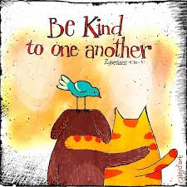

Slide 13
No putting others down

Slide 14
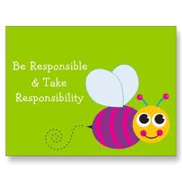
4. Be responsible

Slide 15
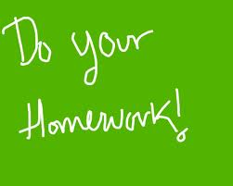
Hand in your assignments on time

Slide 17
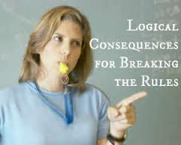
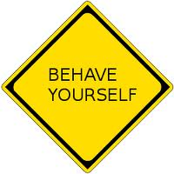
Consequences

Slide 18
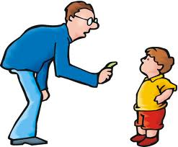
If you are being disrespectful…….
I will write down your name on the blackboard and only give you one warning.

Slide 19
If you do not hand in your homework on time,
grade reduction
If you do not turn in your homework,
you get zero

Slide 20
我們的約定
有禮貌(Be polite.)
愛整潔 (Be tidy.)
有規矩(Behave yourself.)
負責任(Be responsible.)

Slide 21
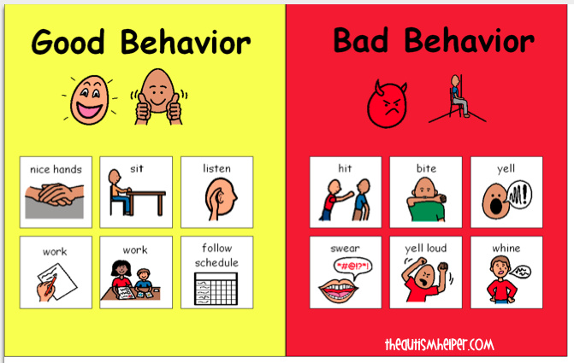

Slide 22
Classroom Rules Student Contract
I agree to follow these rules:
_______________________________
_______________________________
_______________________________
_______________________________
Signed _________________
Date _____________________

Slide 23
http://printables.atozteacherstuff.com/476/classroom-school-rules-student-contract/

Slide 25
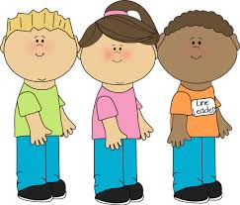
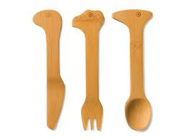
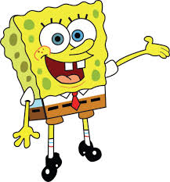
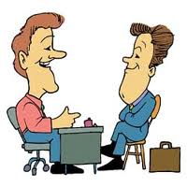
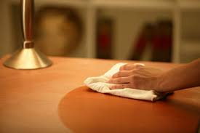
排隊打菜。
輕放用具。
閉口嚼食。
輕聲細語。
清理桌面。

Slide 26
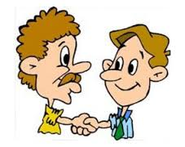
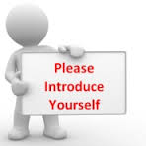

Slide 27
Two people in a group. You have to introduce each other.
Tell your partner five things that you would like people to know about you.

Slide 28
He / She is …….
He/She likes……
His /Her name is ……..

